Slide 1
DEVELOPMENT OF SOFTWARE TOOL FOR LOW COST THERMAL IMAGING SYSTEM
BY
Arivazhagan M - 2019116006
Arunachalam U - 2019116007
Sai Sanjay P – 2019116037
PROJECT GUIDE:
DR. M. SASIKALA
Professor, Director,
Centre for Medical Electronics
College of Engineering, Guindy.

Slide 2
ABSTRACT
Infrared thermography is the method of detecting infrared radiation which is emitted from an object and displaying it as a temperature distribution on the image.
IRT is very convenient, reliable, non-contact and cost-effective method that enables the measurement in real time. MLX90640 is widely used thermal sensor which contains 32X24 IR array.
This low-cost thermal imaging plays a vital role in the field of healthcare. Hence there is a need to develop a software tool for analyzing the thermal images.

Slide 3
A sequence of thermal frames obtained by the MLX90640 sensor is transmitted to HTTP clients for displaying in the user interface. The software is used to obtain and store the image captured by the infrared thermal sensor, so as to facilitate the subsequent temperature research and analysis.
It can be used for the detection of breast cancer, fever screening, thyroid disease detection and early detection of diabetic foot.

Slide 4
LITERATURE SURVEY
TITLE | YEAR | AUTHOR | JOURNAL | INFERENCE
Open source software for processing images from infrared thermal cameras | 2022 | Gustavo Pereyra Irujo Alex James | PeerJ Computer Science | Most IR cameras comes with built-in software attached, extracting desired parameters is difficult from it. Developing a software tool provides open-source, flexible tools for processing, measuring and reporting the thermal imaging data.
An Analysis Software utilizing Thermal Image, Emissivity calibration and maintenance rules | 2022 | Sumitra Khatchapa, Benyapa Suthumwutinun, et al | International Electrical Engineering Congress (iEECON) | Suggested a method to develop software for analysis of Emissivity Calibration and Maintenance rules. The faulty power distribution equipment from a thermal image was detected based on the local temperature gradient.
Low-cost thermal camera-based counting occupancy meter facilitating energy saving in smart buildings | 2021 | Marek kraft, Przemyslaw Aszkowski, Dominik Pieczynski, Michal Fularz | MDPI open access | Low power, low resolution thermal camera for person counting provided a relatively higher accuracy than simple binary occupancy sensors. The solution also preserves the privacy of the users as identity recognition using input images is impossible due to the utilized modality and low resolution.

Slide 5
TITLE | YEAR | AUTHOR | JOURNAL | INFERENCE
Development of Low-cost thermal imaging system as a preliminary screening instrument | 2019 | Bhargavi Haripriya Dr. K. A. Sunitha Mahima B | Procedia Computer Science | General market survey of the available thermal cameras were studied. Thermal images can be used to detect diabetic foot ulcers that have significant temperature differences.
Prediction of Thermal sensation using low-cost infrared array sensors monitoring system | 2019 | Yuxin Wu et al, | IOP Science Conference Series | The low-cost infrared camera (MLX90640) with accuracy of 2 ºC and resolution of 32x24 pixels is able to be used to predict thermal sensation. The camera has performance better than skin temperature measure system including thermocouples
Development of a Low-cost Thermal Camera for Electrical Condition Monitoring | 2019 | Min Qi Ng Soo Siang Teoh, | Universal Journal of Electrical and Electronic Engineering | Continuous monitoring of equipment temperature and provide a warning signal when reaches an alarming level using MLX90640 thermal array sensor, a visual camera and an LCD display and Raspberry Pi 3.

Slide 6
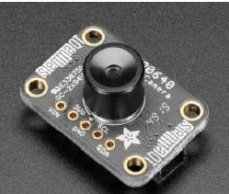
MLX90640 IR THERMAL CAMERA
The Camera sensor measures the temperature change and converts it into analog voltage. The analog voltage is converted into temperature using
V = k (T_{obj}⁴ – T_{s}⁴)
T_{obj} = (V/k + T_{s}⁴)^{1/4}
FEATURES
Small size
Resolution :32x24 pixels IR array
Accuracy: ±1 ºC
3.3V supply voltage
Current consumption less than 23mA
Operating temperature: -40 to 85 ºC

Slide 7
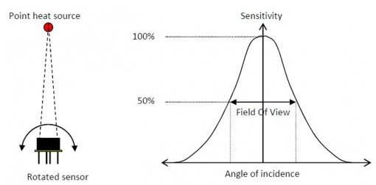
MEASUREMENT PRINCIPLE
The FOV of this module is determined by 50% radiation signal which is received by the thermopile; it is also influenced by the main axis of the sensor. The temperature measured is the weighted average of the detected object's temperature in FOV.
Applications:
➢ High precision non-contact temperature measurement
➢ Temperature sensing element for intelligent building air conditioning Visual IR thermometers.

Slide 8
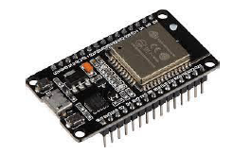
ESP32
A feature-rich MCU with integrated Wi-Fi and Bluetooth connectivity for wide-range of applications. It is capable of functioning reliably in industrial environments, with an operating temperature ranging from -40°C to +125°C.
Features:
CPU: Xtensa dual-core (or single-core) 32-bit LX6 microprocessor, operating at 160 or 240 MHz and performing at up to 600 DMIPS.
320 KiB RAM, 448 KiB ROM
Wi-Fi: 802.11 b/g/n
• Bluetooth: v4.2 BR/EDR and BLE

Slide 9
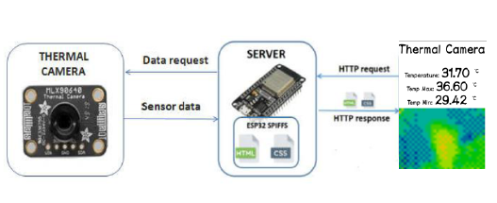
ESP32 operating mode
Soft Access Point (AP):
The ESP32 creates its own Wi-Fi network and acts as a hub for one or more stations. So, such mode of operation is called Soft Access Point (soft-AP). The maximum number of stations that can connect to it is limited to five.

Slide 10
WORK FLOW
Setting up the Arduino IDE for ESP-32
Connect MLX90640 thermal camera with ESP32
Write and upload the code to ESP-32
Display temperature readings fetched from the sensor in serial monitor
Transfer the readings to Webserver on HTTP request
Display the image in app
Develop and deploy the app using Python/ relevant language

Slide 11
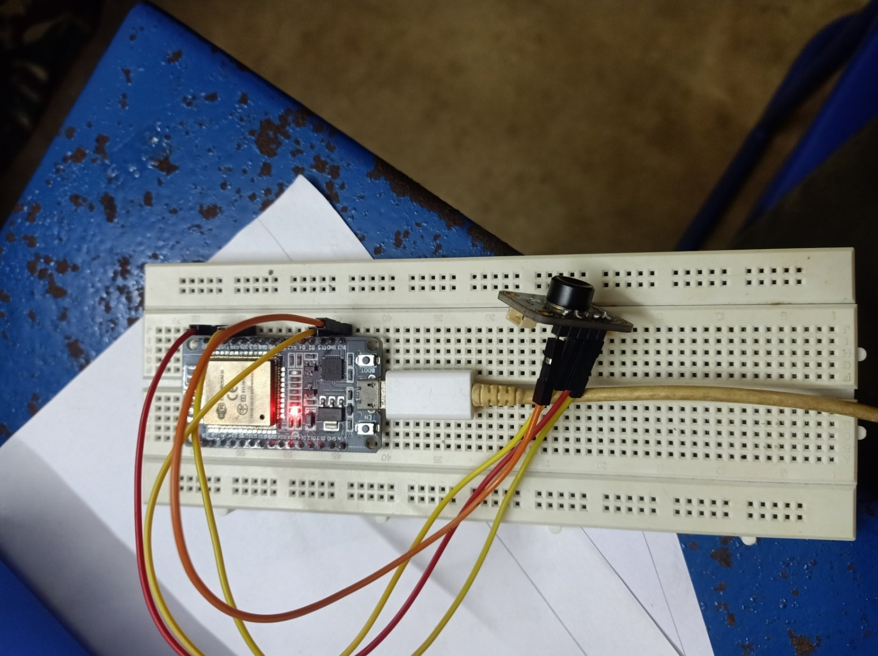
Circuit Connections
ESP32 | MLX90640
3.3V | Vin
GND | GND
D21 | SDA
D22 | SCL
Interfacing of ESP32 with MLX90640

Slide 12
PROGRESS
Setting up the Arduino IDE environment
Steps:
  Install current version of Arduino IDE
  Start Arduino and open preferences Window
  Add Additional Board Manager URLs field
  Open Boards Manager from Tools > Board menu and install esp32 platform
  Restart Arduino IDE

Slide 13
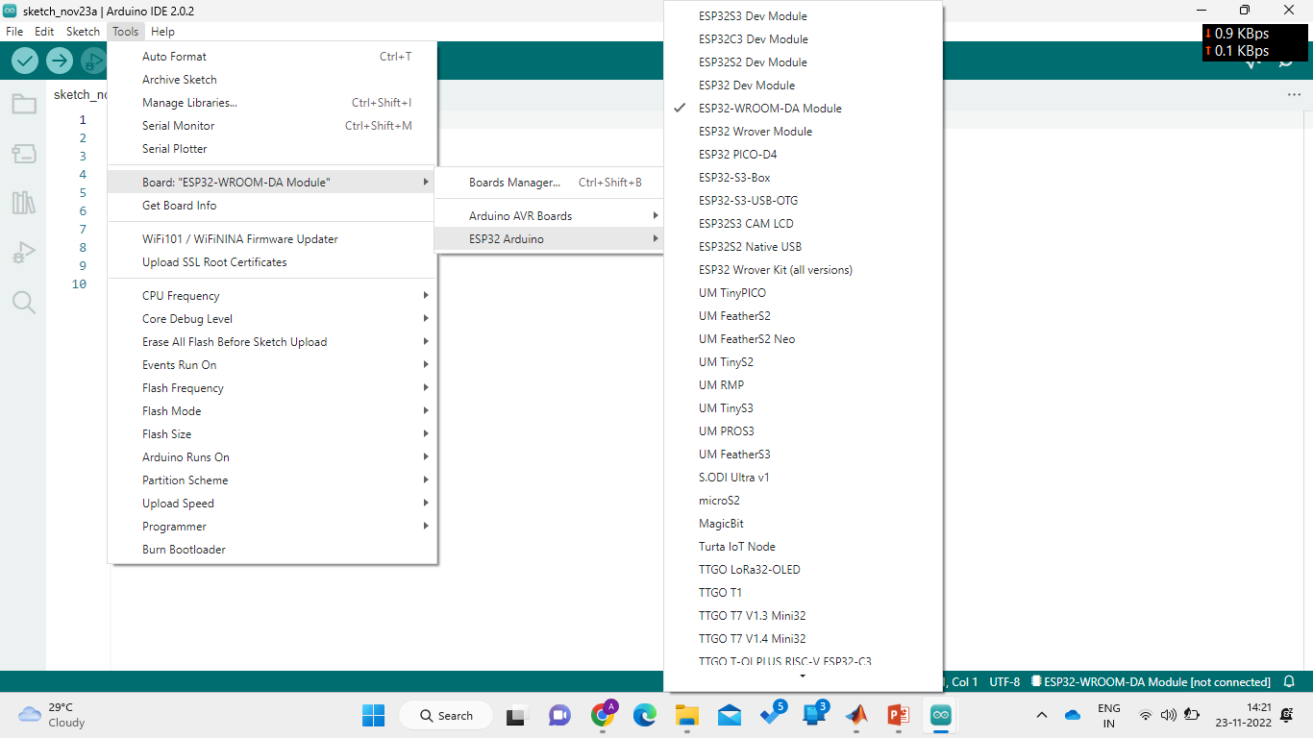
Setting up of IDE for writing the code to ESP32

Slide 14
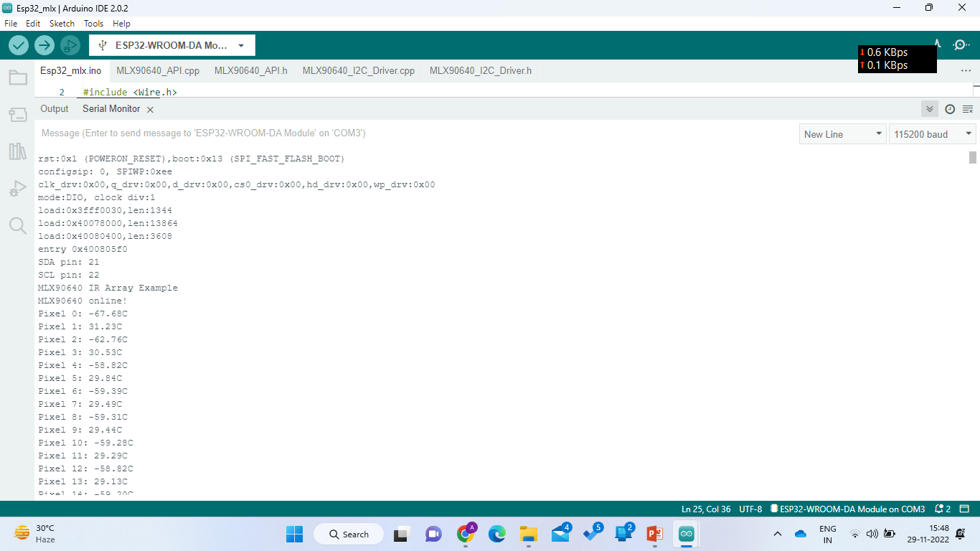
Temperature readings in Serial Monitor

Slide 15
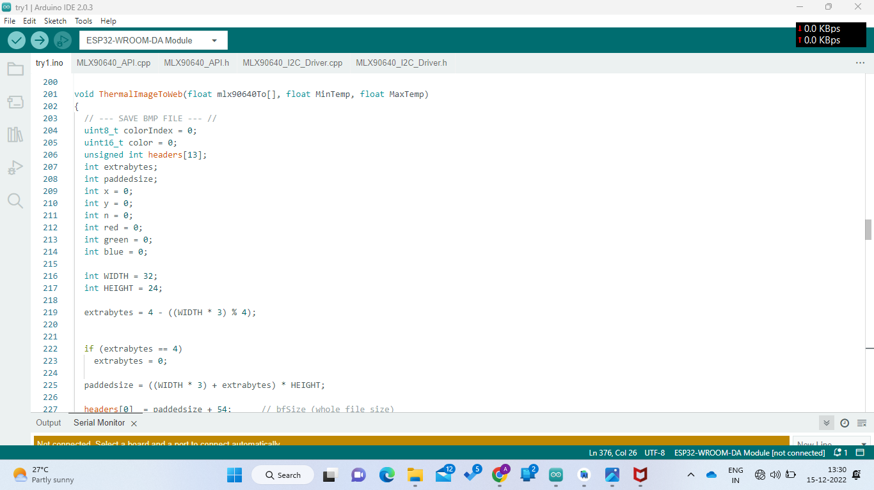
Converting the array of pixel readings from the sensor into a bitmap image file.

Slide 16
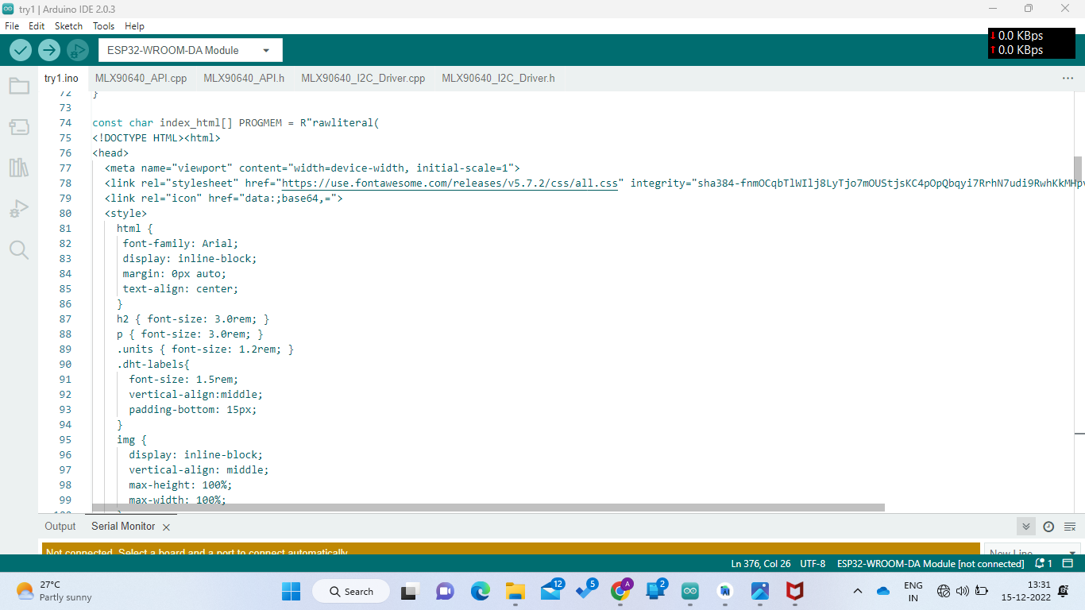
Creating the HTML webpage which displays the image file.

Slide 17
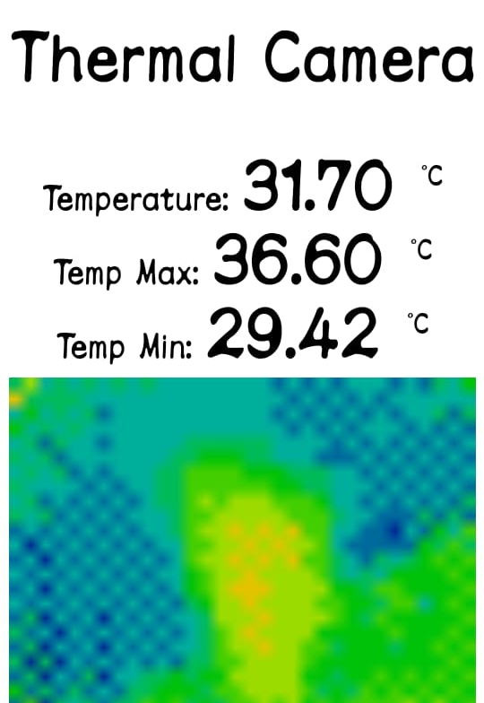
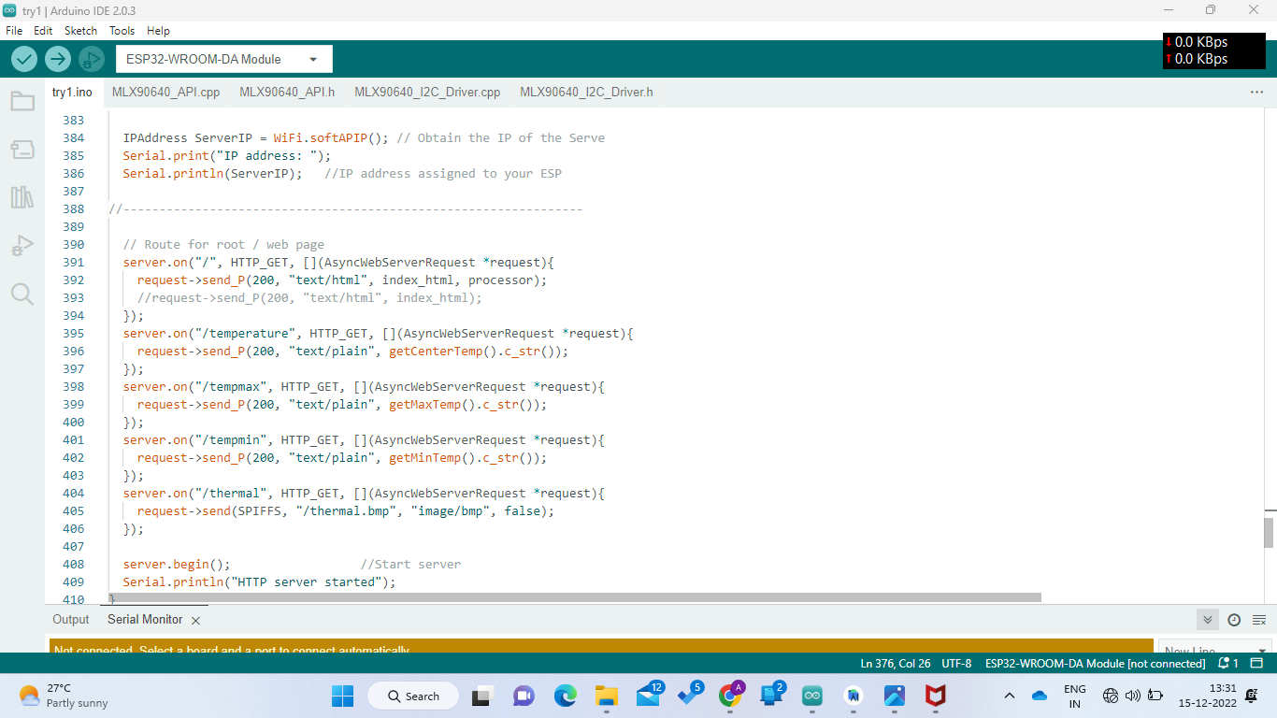
Using the Wi-Fi module of ESP32, the bitmap is transferred to an IP address. Real time viewing of thermal image is done.

Slide 18
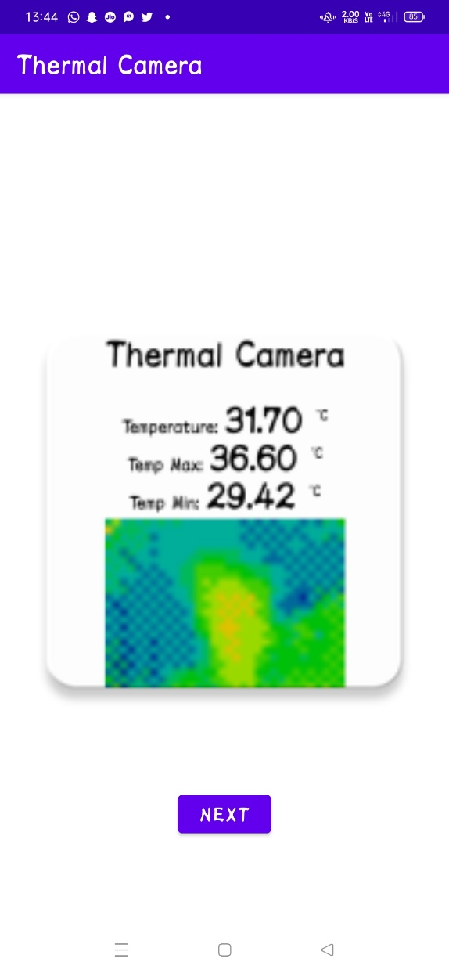
Creation of Android application for easy access and further processing of acquired thermal images. The image is produced using the color map techniques based on temperature values from the sensor.

Slide 19
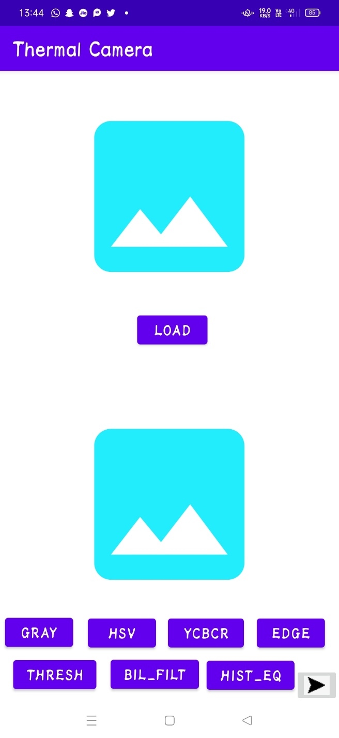
Next page of the application is to load any image from phone’s internal memory and processing it.

Slide 20

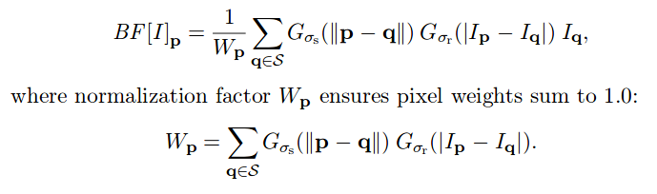
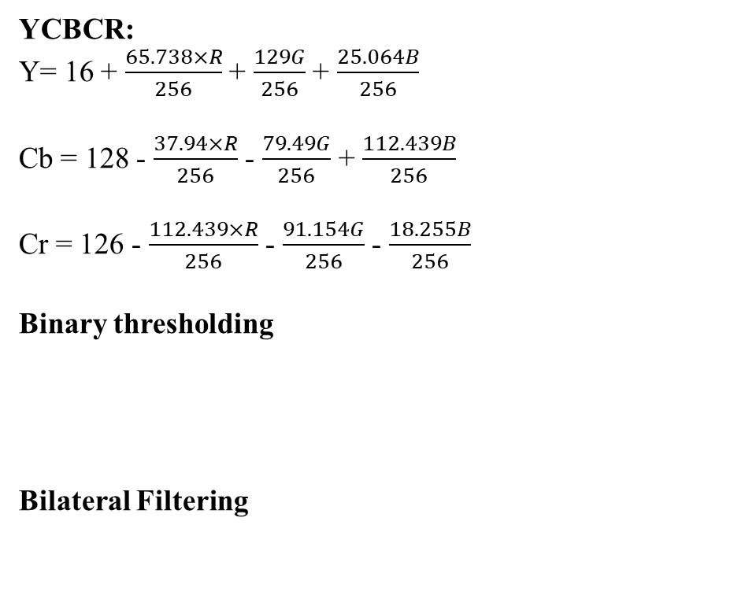
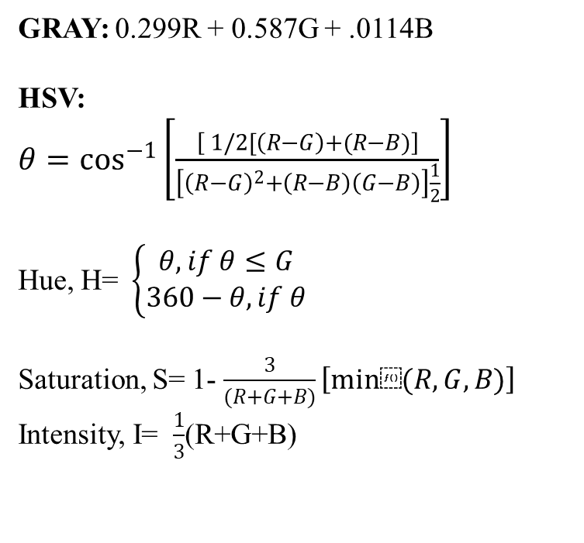
FORMULAS
GRAY: 0.299R + 0.587G + .0114B
HSV:
$θ=\cos^{−1}\left[\frac{\left[ 1/2[\left(R−G\right)+(R−B)\right]}{\left[{\left(R−G\right)}^{2}+\left(R−B\right)\left(G−B\right)\right]\frac{1}{2}}\right]$
Hue, H=$\left\{\begin{aligned}θ, if θ≤G \\ 360−θ, if θ\end{aligned}\right.$
Saturation, S= 1- $\frac{3}{(R+G+B)}\left[min⁡(R,G,B)\right]$
Intensity, I= $\frac{1}{3}$(R+G+B)
YCBCR:
Y= 16 + $\frac{65.738×R}{256}$ + $\frac{129G}{256}$ + $\frac{25.064B}{256}$
Cb = 128 - $\frac{37.94×R}{256}$ - $\frac{79.49G}{256}$ + $\frac{112.439B}{256}$
Cr = 126 - $\frac{112.439×R}{256}$ - $\frac{91.154G}{256}$ - $\frac{18.255B}{256}$
Binary thresholding
Bilateral Filtering

Slide 21
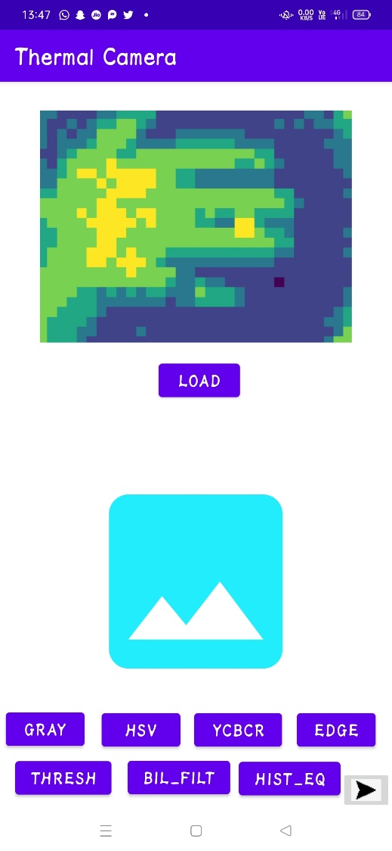
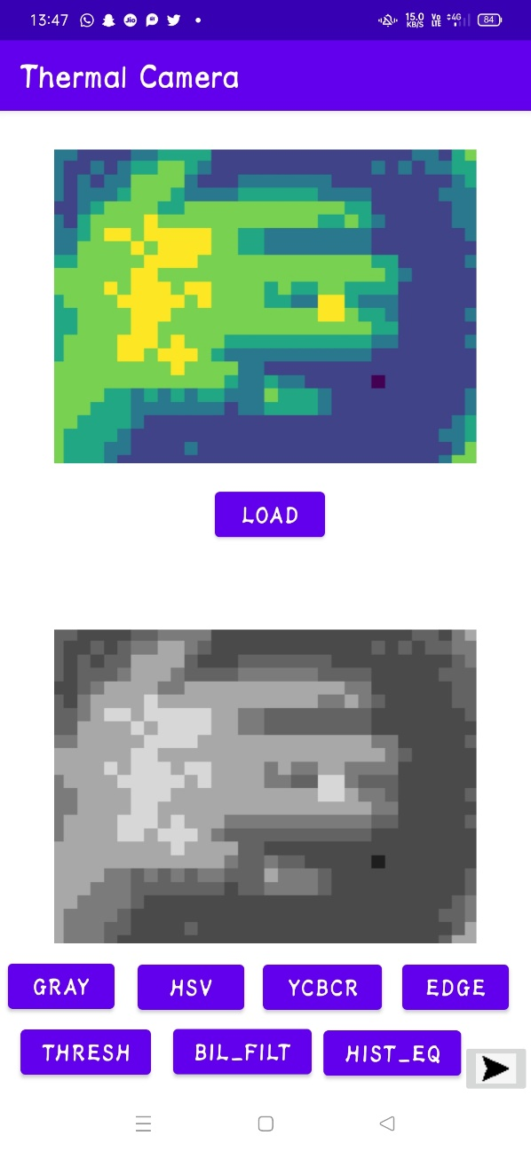
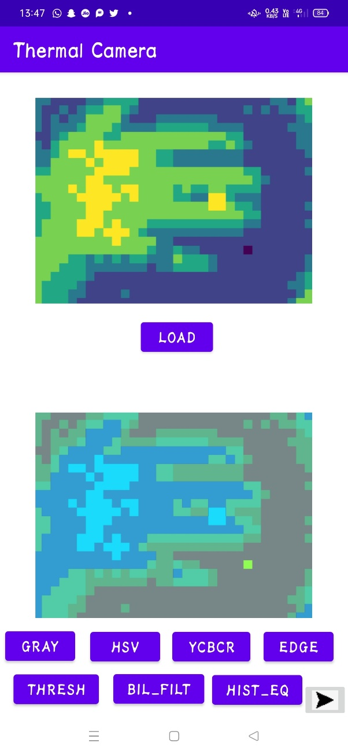
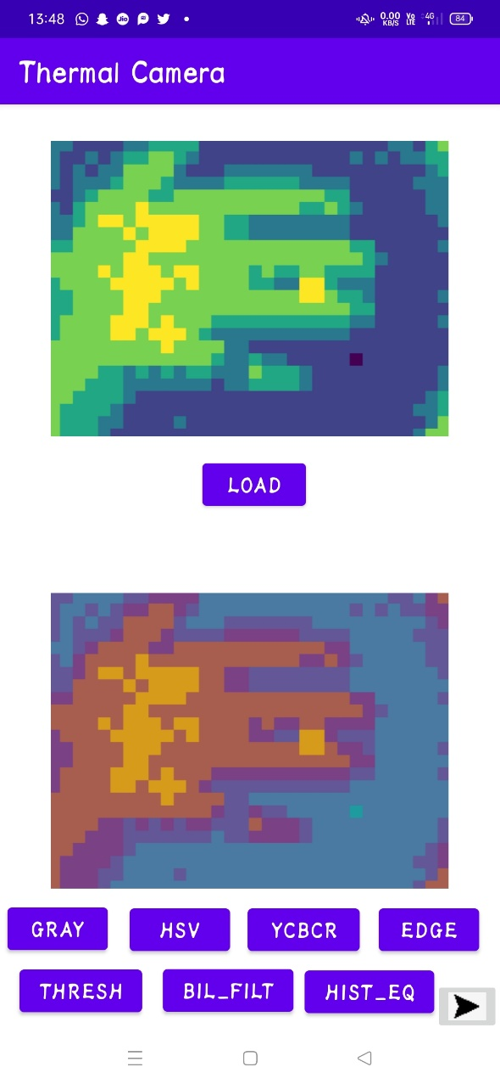
Processing of images:
Loaded Image
Loading thermal image and performing color conversions

Slide 22
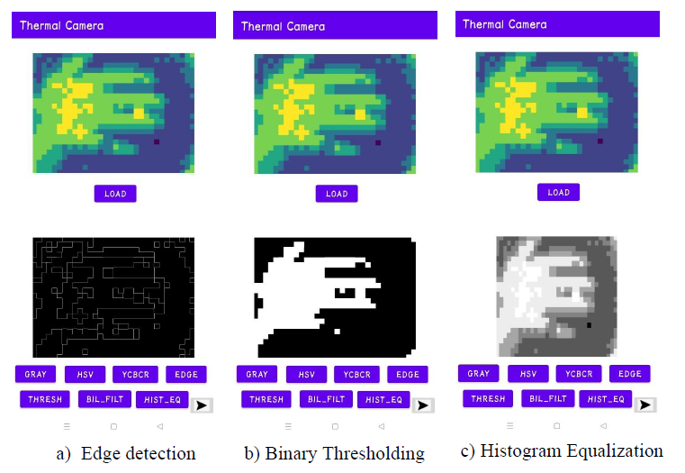
Processing of images:
App displaying edge detected, threshold and histogram equalized images

Slide 23
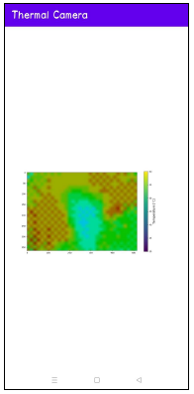
Finally displaying the temperature distribution matrix of the image.

Slide 24
APPLICATIONS IN HEALTHCARE:
Thermal imaging systems are used to diagnose diseases based on the temperature distribution.
It is also used for human fever screening from the distance.
It is used in the medical and veterinary fields for various diagnostic purposes such as detecting tumors and identifying damage to soft tissue which give rise to locally raised temperatures.
It can be used for a wide range of medical applications such as skin cancer detection, monitoring thyroid disorders, identifying diabetic foot ulcers.

Slide 25
CONCLUSION
A low-cost thermal imaging system is developed by interfacing the MLX90640 sensor with ESP32 module. The main objective is met.
An android application is developed that enables the user to view the thermal image in mobile phone.
First page is a web view, once after connecting to the Wi-Fi server ESP32 this page will display the thermal images in real-time along with its minimum, maximum and average temperatures.
Further processing of a thermal image is done and displayed over the app. Then finally temperature distribution color matrix displayed.

Slide 26
REFERENCES:
1) Pereyra Irujo G. IRimage: open source software for processing images from infrared thermal cameras. PeerJ Comput Sci. 2022 May 10;8:e977. doi: 10.7717/peerj-cs.977. PMID: 35634096; PMCID: PMC9138121.
2) S. Khatchapa, B. Suthumwutinun, N. Tanthanuch and D. Bunnjaweht, "An Analysis
Software Utilizing Thermal Image, Emissivity Calibration and Maintenance Rules,"
2022 International Electrical Engineering Congress (iEECON), Khon Kaen, Thailand,
2022, pp. 1-4, doi: 10.1109/iEECON53204.2022.9741584.
3) Kraft, M.; Aszkowski, P.; Pieczyński, D.; Fularz, M. Low-Cost Thermal Camera-
Based Counting Occupancy Meter Facilitating Energy Saving in Smart Buildings.
Energies 2021, 14, 4542. https://doi.org/10.3390/en14154542
4) A. Bhargavi Haripriya, K.A. Sunitha, B. Mahima, Development of Low-cost Thermal
Imaging System as a Preliminary Screening Instrument, Procedia Computer Science,
Volume 172, 2020, Pages 283-288, ISSN 1877-0508, https://doi.org/10.1016/j.procs.2020.05.045.

Slide 27
Yuxin Wu et al 2019 IOP Conf. Ser.: Mater. Sci. Eng. 609 032002, Prediction of
thermal sensation using low-cost infrared array sensors monitoring system.
DOI 10.1088/1757-899X/609/3/032002
Min Qi Ng , Soo Siang Teoh , "Development of a Low-cost Thermal Camera for
Electrical Condition Monitoring," Universal Journal of Electrical and Electronic
Engineering, Vol. 6, No. 5A, pp. 94 - 99, 2019. DOI: 10.13189/ujeee.2019.061511.
N. Gu, B. Yang and T. Zhang, "Dynamic Fuzzy Background Removal for Indoor
Human Target Perception Based on Thermopile Array Sensor," in IEEE Sensors
Journal, vol. 20, no. 1, pp. 67-76, 1 Jan.1, 2020, doi: 10.1109/JSEN.2019.2942320.
https://chaquo.com/chaquopy/doc/current/android.html
https://learn.adafruit.com/adafruit-mlx90640-ir-thermal-camera/arduino
https://community.hiveeyes.org/t/getting-the-mlx90640-ir-sensor-running-with-anesp32/1383/4
https://www.tutorialspoint.com/android/android_studio.htm

Slide 28
THANK YOU

